Slide 1

Data Analysis of Singapore Weather Patterns to Identify Means to Optimise Households Energy Consumption by Town

Slide 2

Data Analyst of a vendor hired by Government
Government wishes to promote usage of energy efficiency across island.
They will run pilot projects for 3-5 towns in Singapore and needs some insights how to approach it.

Slide 3
Problem Statement
Weather can potentially impact energy consumption as usage patterns in response to weather conditions.
Analysing the relationship between Singapore weather and energy consumption across town, we can identify opportunities to promote more efficient practices and optimise energy usage.

Slide 4
Methodology
Step 1 : Monthly weather pattern in Singapore
Step 2 : Relationship between various monthly weather data
Step 3 : Energy consumption pattern per month across town in Singapore
Step 4 : Relationship between average energy consumption across town
Step 5 : Relationship between various monthly weather data and energy consumption across town

Slide 5
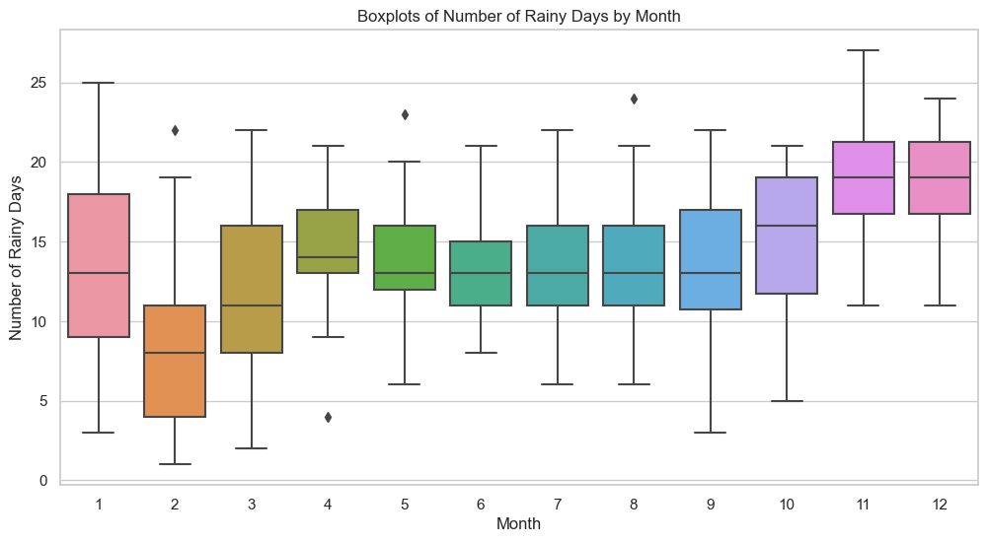
Nov – Jan rains the most.

Slide 6
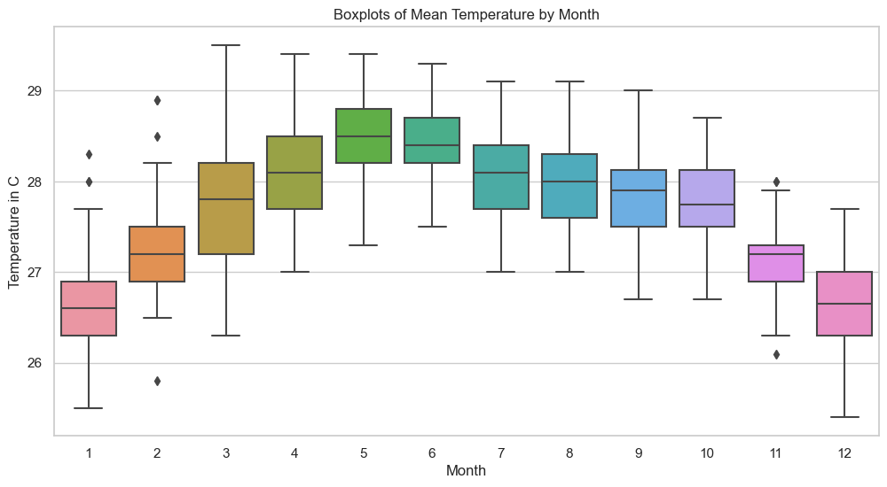
May is the hottest in Singapore

Slide 7
Step 2: Important Relationship between Weather Data
total rainfall in a month and maximum rainfall in a day have strong positive correlation (r = 0.81).
total rainfall and mean temperature have very mild (less than expected) negative correlation (r = -0.51).

Slide 8

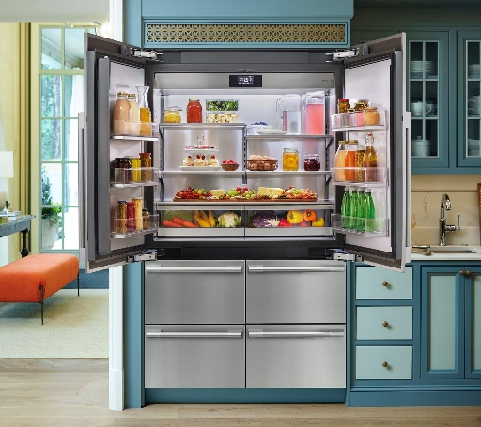


Major Source of Energy Consumption in Household
5-ticks AC
200 to 250 kWh per month
Refrigerator
6 kWh per
wash/dry cycle
Water Heater
60 to 80 kWh per month
Washer/Dryer
6 kWh per
wash/dry cycle

Slide 9
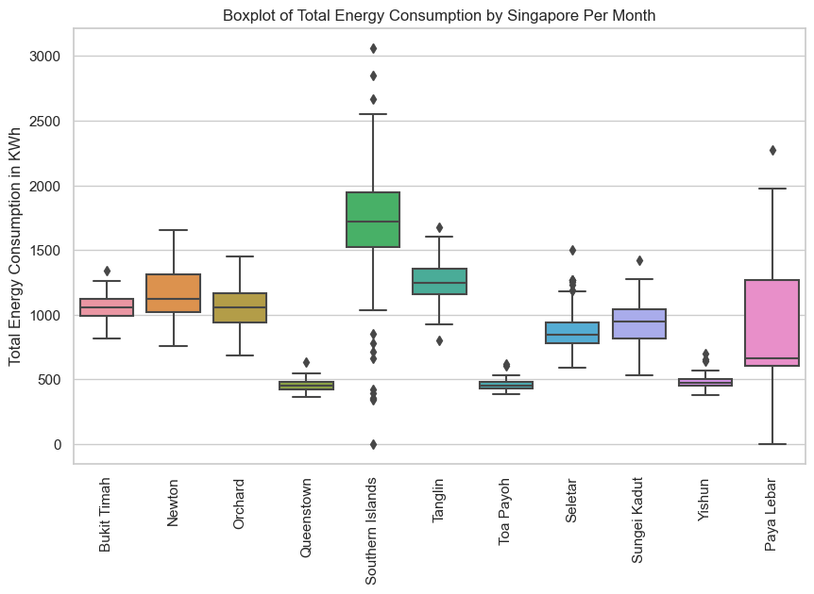
Mean
648 kWh per month

Slide 10
Step 3: Energy Consumption Patterns
Energy Area | Average Household Consumption per Month (kwh) | Mean Household Consumption per Month (kWh) | Multiplier
Bukit Timah | 1058 | 648 | 2x
Newton | 1164 |  | 2x
Orchard | 1063 |  | 2x
Paya Lebar | 907 |  | 1.5x
Seletar | 869 |  | 1.4x
Southern Island | 1574 |  | 3x
Tanglin | 1253 |  | 2x
Sungei Kadut | 932 |  | 1.5x

Slide 11
Opportunities
Area | Multiplier | Possible Reason and Potential Remedy
Bukit Timah | 2x | Campaign that focus on Landed Properties
Newton | 2x
Orchard | 2x
Tanglin | 1.5x
Southern Island | 1.4x
Paya Lebar | 3x | Campaign that focus on Landed Properties
Seletar | 2x
Sungei Kadut | 1.5x | Campaign that focuses on Light Industrial Factories

Slide 12
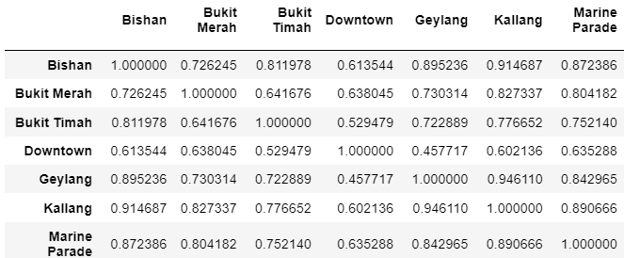
The table below shows a collection of correlation coefficients (r) between the variables below.
For example, Energy Consumption in Bishan is 0.726245 correlated with Bukit Merah.

Slide 13
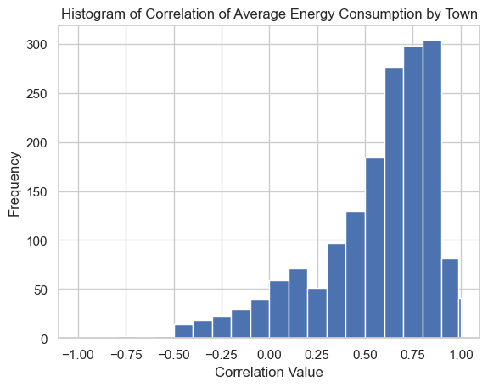
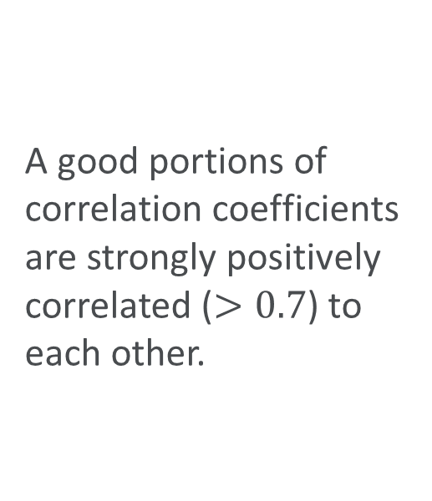
Step 4: Relationship between average energy consumption across town
A good portions of correlation coefficients are strongly positively correlated ($>0.7$) to each other.

Slide 14
Relationship between Energy Consumption across town
The energy consumption patterns across towns are similar.
Push for one successful campaign in a town
Expand our campaigns to all towns

Slide 15
How weather could potentially connect to energy consumption
Possibility 1
People stays at home more during rainy seasons
=> More household energy consumption
Possibility 2
Air-conditioner / Water Heater are used more during hot seasons
More household energy consumption

Slide 16
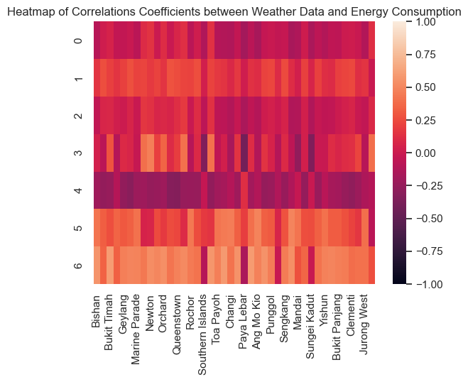
Step 5 : Relationship between various monthly weather data and energy consumption across town

Slide 17
Summary of Recommendations
The recommended campaign from us will not be weather-dependent.
Bukit Timah, Newton, Orchard, Tanglin and Southern Islands are
top target audience for energy consumption campaign
the campaign will be electricity consumption focused
Any successful recommendations are expandable to all other towns due to the high level of similiarity between energy consumption patterns across areas.

Slide 18
Appendix
Boxplot of Monthly Electricity Consumption across all towns
Boxplot of Monthly Electricity Consumption across selected towns
Boxplot of Monthly Gas Consumption across all towns
Boxplot of Monthly Gas Consumption across selected towns
Boxplot of Monthly Total Energy Consumption
Table of Housing Type by Percentage
Boxplot of Total Rainfall by Month

Slide 19
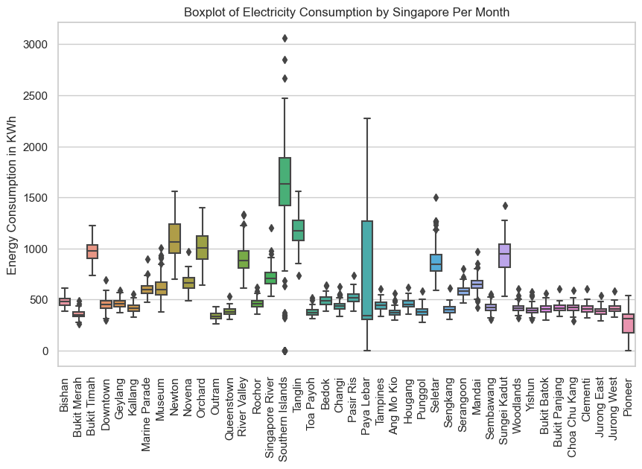

Slide 20
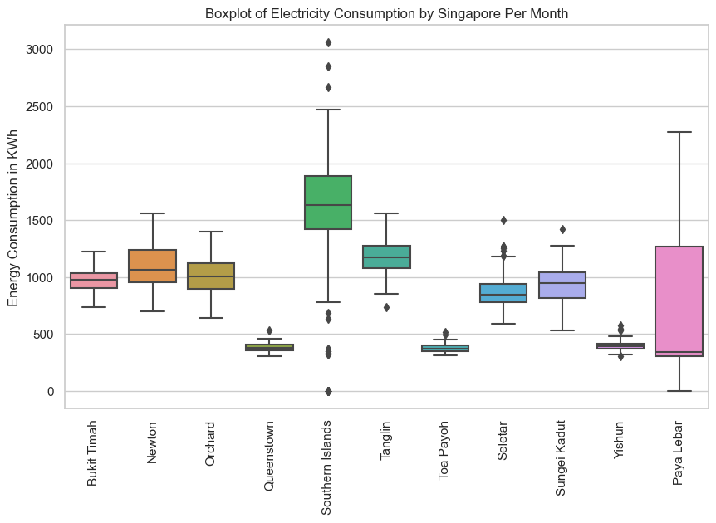

Slide 21
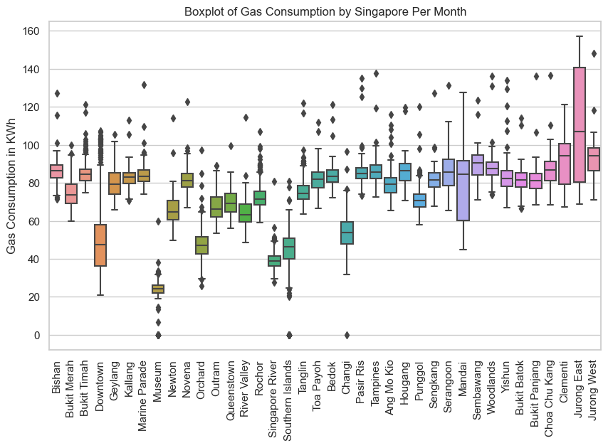

Slide 22
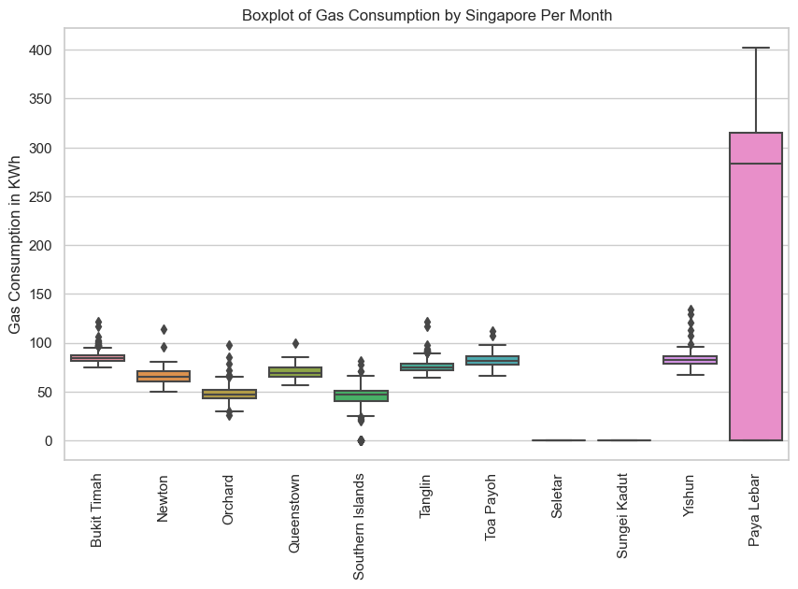

Slide 23
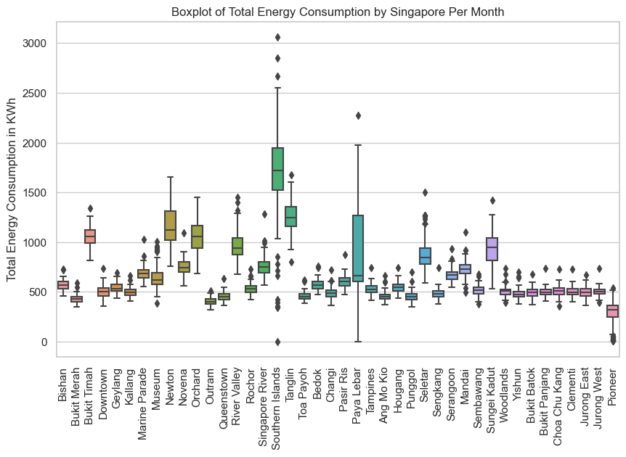
mean
648 kWh per month

Slide 24
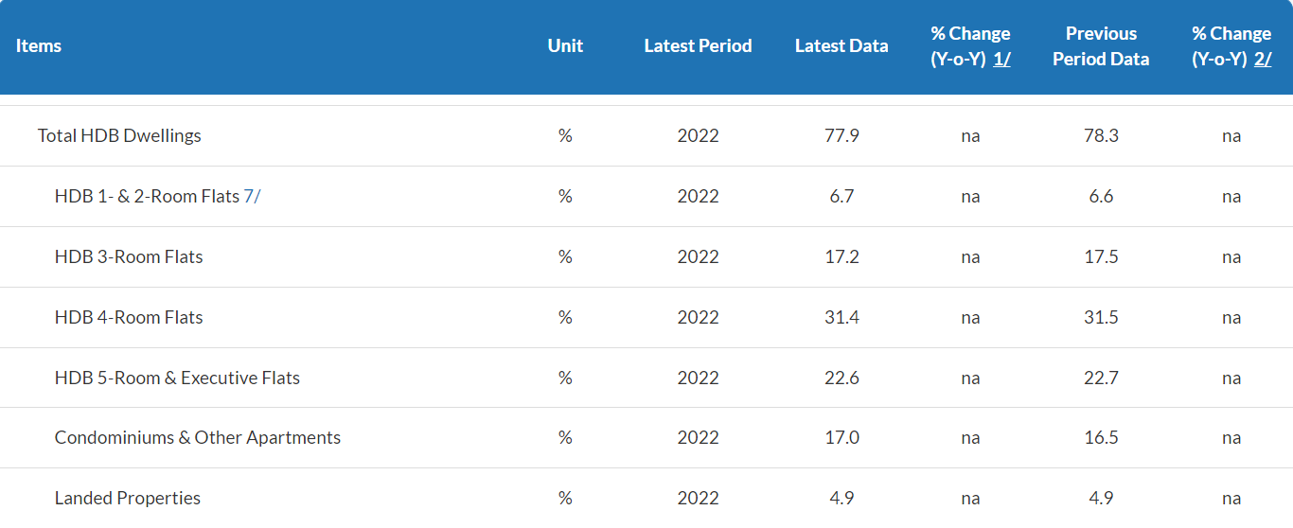
Housing Type by Percentage

Slide 25
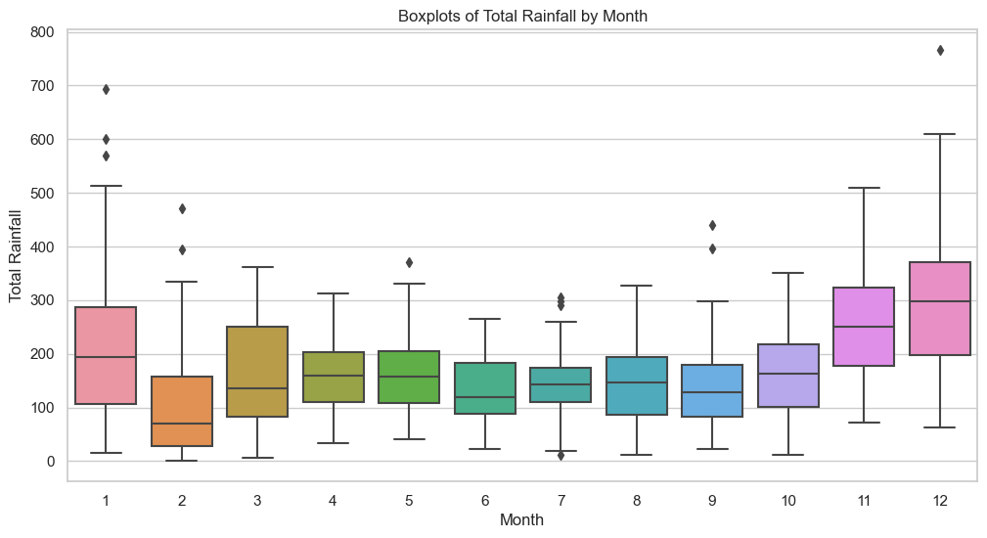
Dec is the wettest month.

